Slide 1


<Sucheng Li>
<Feb 17>

Slide 2

Outline
Executive Summary
Introduction
Methodology
Results
Conclusion
Appendix

Slide 3
Executive Summary
Summary of methodologies:
Data collection through API and Web Scraping
Data wrangling
Data Analysis with SQL, Visualizations, and Folium
Machine Learning for prediction
Summary of all results
Exploratory results
Interactive results from Dash
Predictive results form Machine Learning

Slide 4
Introduction
Project background and context
Falcon 9 rocket is a launched by Space X on several launch sites. The major cost saving is from reusing of the first stage. Thus, if the first stage will land would have significant influences on the overall launching cost. By exploring data from different sources with various tools, this project aims to explain the correlation between all the recorded factors and the likelihood of launch success. A machine pipeline is built in the end.
Problems you want to find answers
What are the factors (features) that impact landing?
What is the correlation between the features and success rate of landing?

Slide 5

Section 1

Slide 6
Methodology
Executive Summary
Data collection methodology:
API
https://api.spacexdata.com/v4
Web Scraping
https://en.wikipedia.org/w/index.php?title=List_of_Falcon_9_and_Falcon_Heavy_launches&oldid=1027686922
Perform data wrangling
A True/False labels were added to the data set to indicate the success result of landing.
Data was filtered and cleaned
Missing values were handled with mean

Slide 7
Methodology
Executive Summary
Perform exploratory data analysis (EDA) using visualization and SQL
Perform interactive visual analytics using Folium and Plotly Dash
Perform predictive analysis using classification models
Data was normalized and then divided into training set and testing set.
Evaluated by different Machine Learning Algorithms, the overall accuracy was recorded.

Slide 8
Data Collection
Describe how data sets were collected.
Data sets are collected from API and Web scraping.
You need to present your data collection process use key phrases and flowcharts

Slide 9
Data Collection – SpaceX API
Get data from Space X API
GET data from the Space X API → Filter data → clean data and handle missing values
GitHub URL: https://github.com/kkgob/IBM_ds_final/blob/main/parts_before_dash/spacex-data-collection-api.ipynb
Filter data (keep ”Falcon 9”)
Clean data/ handle missing values

Slide 10
Data Collection - Scraping
Get data from Wikipedia(HTML)
Web scraping Wikipedia → find HTML table header → create table and save as .csv
GitHub URL:
https://github.com/kkgob/IBM_ds_final/blob/main/parts_before_dash/webscraping.ipynb
Find tables, handle tags
Create table, Save as csv

Slide 11
Data Wrangling
Collect data
Collect data → Count the number and occurrence of each orbit → add land outcome label → export as .csv
You need to present your data wrangling process using key phrases and flowcharts
Add the GitHub URL: https://github.com/kkgob/IBM_ds_final/blob/main/parts_before_dash/Data%20wrangling.ipynb
Count number and occurrence of each orbit
Add land outcome label
Export as .csv file

Slide 12
EDA with Data Visualization
Summarize what charts were plotted and why you used those charts:
Flight number vs Launch → check the flight number distribution in the launch sites
Payload mass vs Launch Site → check the payload distribution in the launch sites
Success rate by orbit type → check which orbits have the highest success rate
Flight number vs Orbit type → check if there is any relationships between flight number and orbit type
Payload mass vs Orbit type → check if there is any relationships between payload mass and orbit type
Launch success rate over years → investigate the historical data
GitHub URL: https://github.com/kkgob/IBM_ds_final/blob/main/parts_before_dash/edadataviz.ipynb

Slide 13
GitHub URL:
https://github.com/kkgob/IBM_ds_final/blob/main/parts_before_dash/eda-sql-coursera_sqllite.ipynb
EDA with SQL
Using bullet point format, summarize the SQL queries you performed
Find the names of the unique launch sites
Find 5 records where launch sites begin with `CCA`
Calculate the total payload carried by boosters from NASA
Calculate the average payload mass carried by booster version F9 v1.1
Find the dates of the first successful landing outcome on ground pad
List the names of the booster which have carried the maximum payload mass
List the names of boosters which have successfully landed on drone ship and had payload mass greater than 4000 but less than 6000
Calculate the total number of successful and failure mission outcomes
List the names of the booster which have carried the maximum payload mass
List the failed landing outcomes in drone ship, their booster versions, and launch site names for in year 2015
Rank the count of landing outcomes (such as Failure (drone ship) or Success (ground pad)) between the date 2010-06-04 and 2017-03-20, in descending order

Slide 14
Build an Interactive Map with Folium
Summarize what map objects such as markers, circles, lines, etc. you created and added to a folium map
All launch sites in US → show all the locations of the launch sites
Launch sites with circles and labels → show the cluster of launch sites on the map
Distance to the highway → A example of the distance from one launch site to one highway
GitHub URL:
https://github.com/kkgob/IBM_ds_final/blob/main/parts_before_dash/lab_jupyter_launch_site_location.ipynb

Slide 15
Build a Dashboard with Plotly Dash
Summarize what plots/graphs and interactions you have added to a dashboard
Pie chart → visualize the data for both all sites and individual sites
Scatter Plot → visualize the data for both all sites and individual sites
Payload range → adjust the filter for payloads
Add the GitHub URL:
https://github.com/kkgob/IBM_ds_final/tree/main/dash

Slide 16
Predictive Analysis (Classification)
Collect data/ divided into test, training sets
Summarize how you built, evaluated, improved, and found the best performing classification model
You need present your model development process using key phrases and flowchart
Add the GitHub URL:
https://github.com/kkgob/IBM_ds_final/blob/main/SpaceX_Machine%20Learning%20Prediction_Part_5.ipynb
Train model
Test model
Confusion matrix

Slide 17
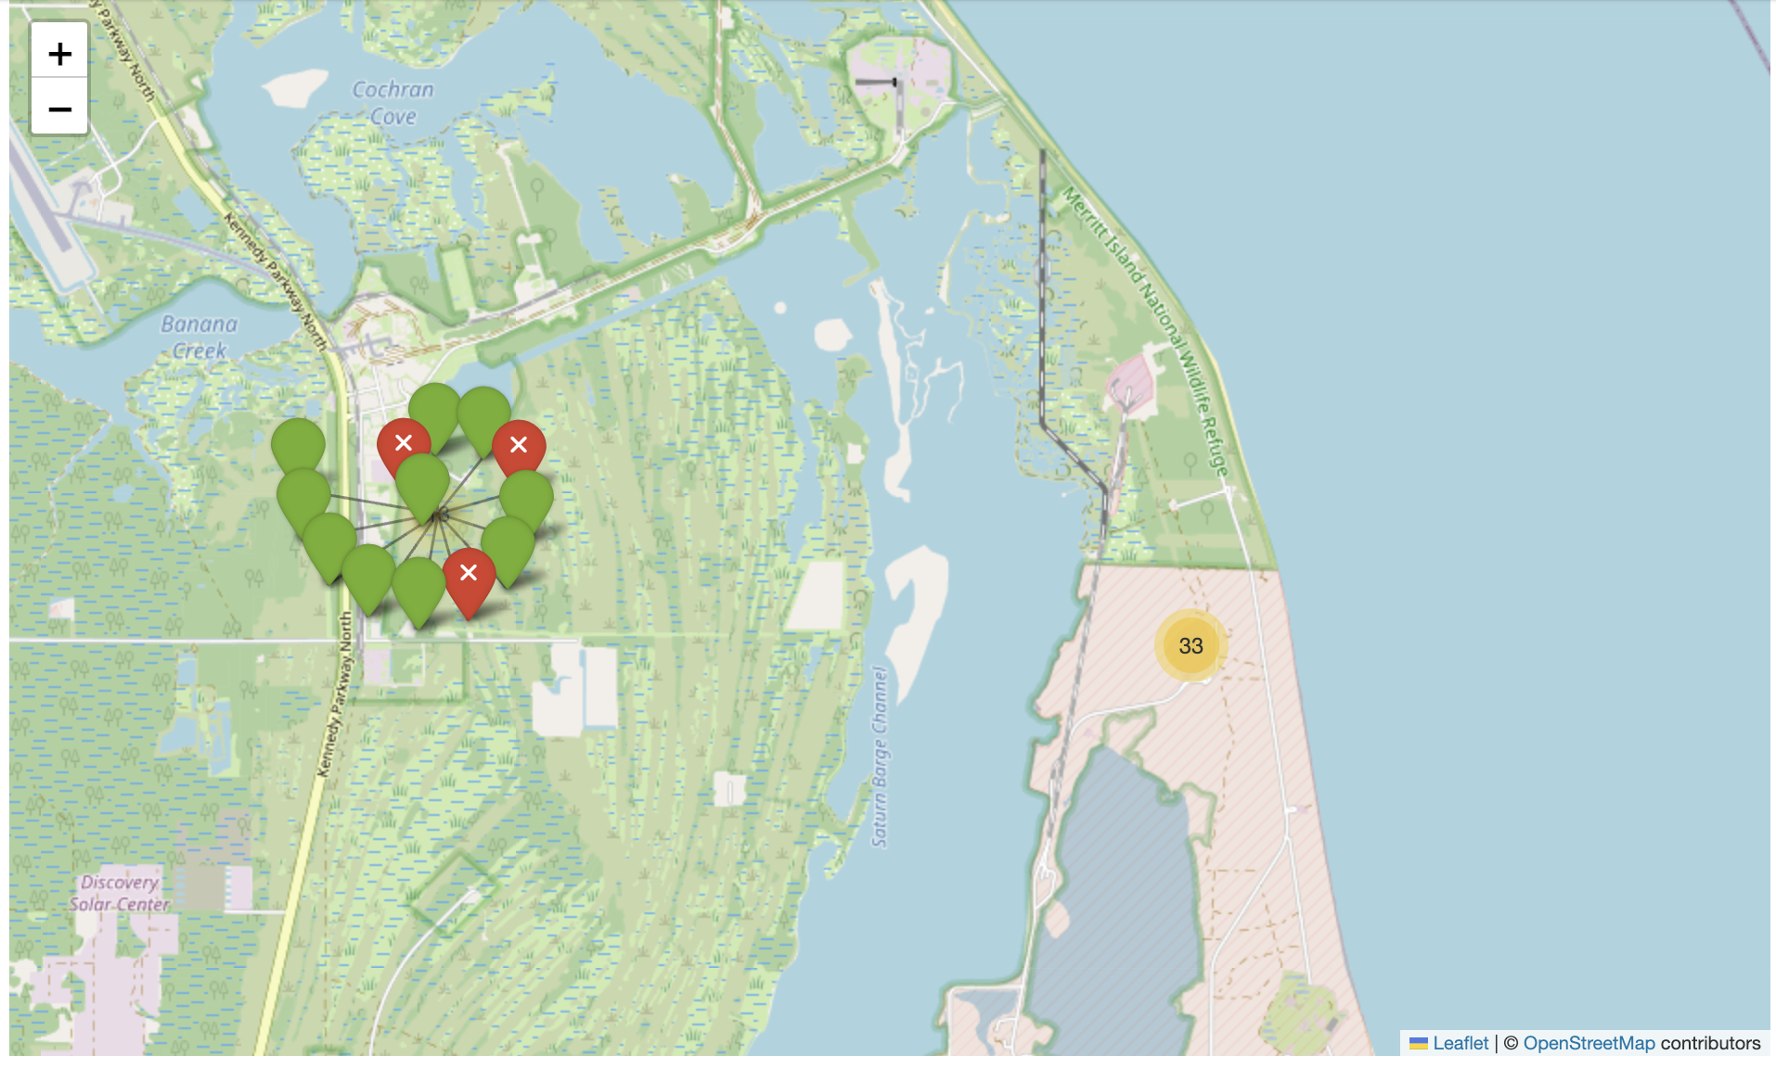
Results
Exploratory data analysis results
The larger the flight amount at a launch site, the greater the success rate at a launch site.
Higher payloads generally have a higher success rate
The success rate is increasing over the years
Interactive analytics demo in screenshots
Predictive analysis results
The Decision Tree model achieved the highest classification accuracy (89%), making it the most effective at predicting landing outcomes.

Slide 18

Section 2

Slide 19
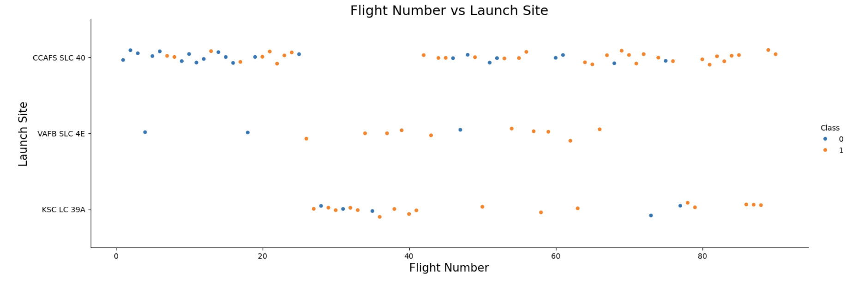
Flight Number vs. Launch Site
Show a scatter plot of Flight Number vs. Launch Site
Explanations:
The larger the flight amount at a launch site, the greater the success rate at a launch site.

Slide 20
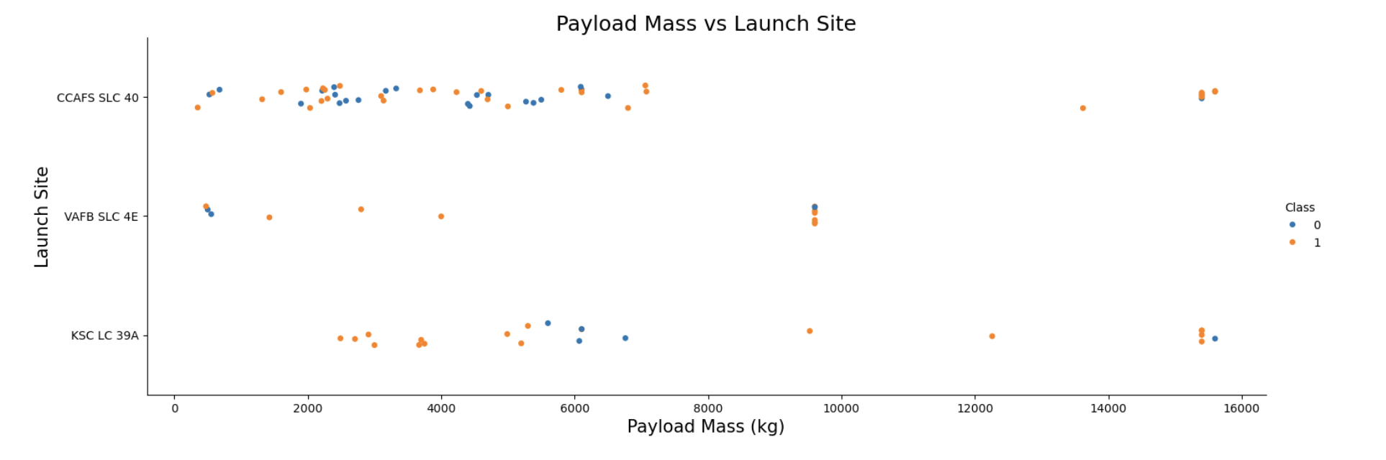
Payload vs. Launch Site
Show a scatter plot of Payload vs. Launch Site
Explanations:
Higher payloads generally have a higher success rate

Slide 21
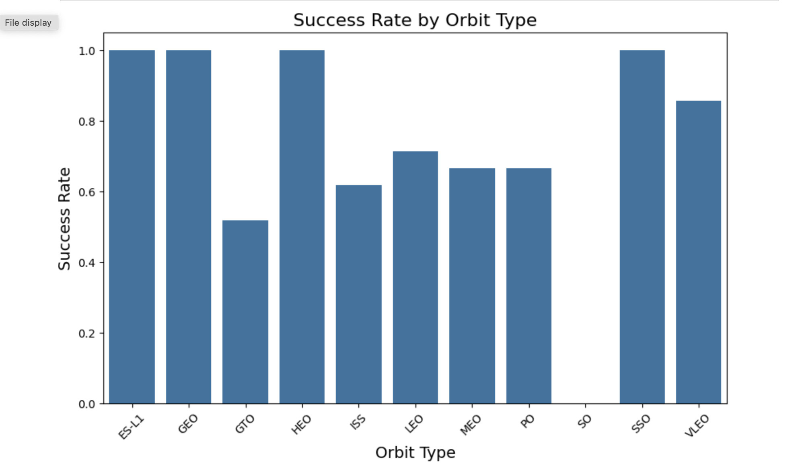
Success Rate vs. Orbit Type
Show a bar chart for the success rate of each orbit type
Explanations:
GTO has the lowest success rate, likely due to its demanding orbital insertion process.
SSO, GEO, and ES-L1 are the most reliable orbits with a 100% success rate.
LEO and ISS missions have moderate success rates, indicating challenges in launching to these orbits but also improvements over time.
Overall, SpaceX has achieved high reliability for most orbits, with improvements seen in high-demand orbits like LEO and ISS.

Slide 22
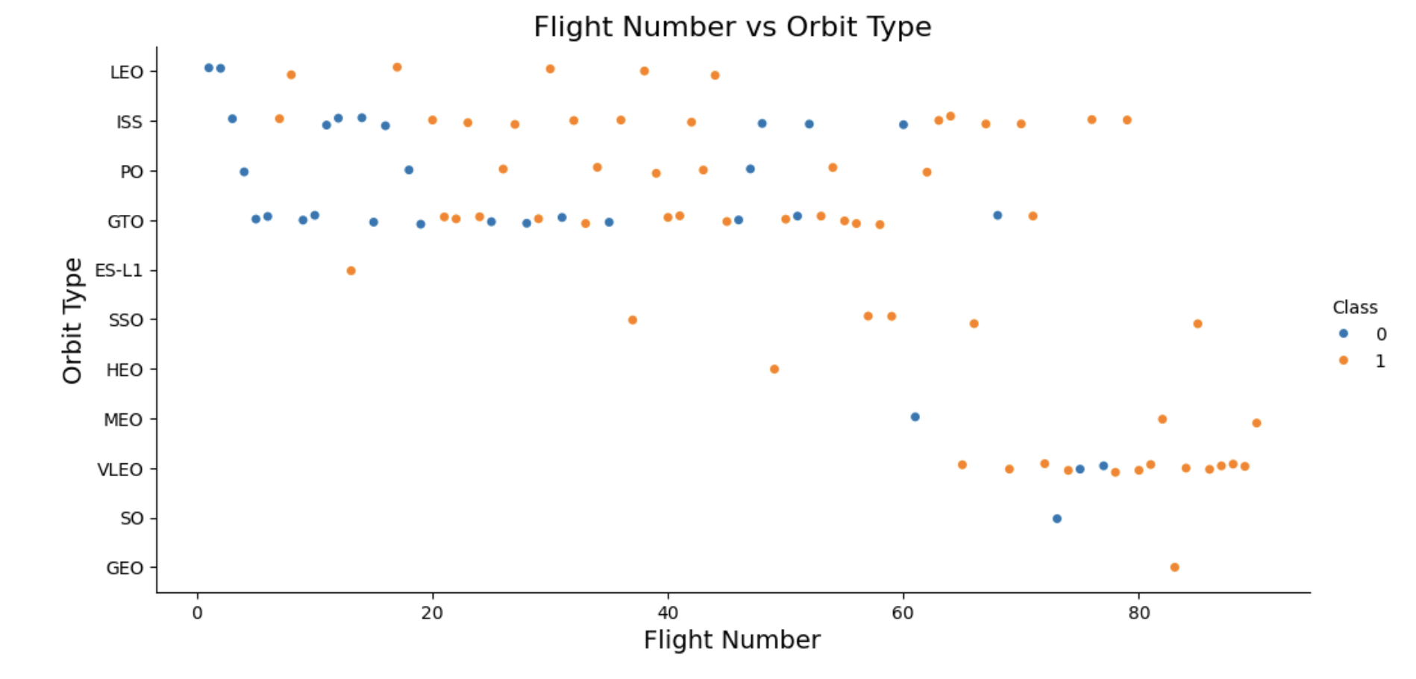
Flight Number vs. Orbit Type
Show a scatter point of Flight number vs. Orbit type
Explanations:
You can observe that in the LEO orbit, success seems to be related to the number of flights. Conversely, in the GTO orbit, there appears to be no relationship between flight number and success.

Slide 23
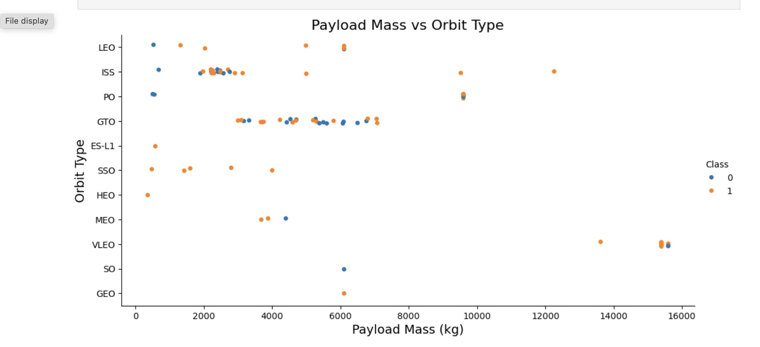
Payload vs. Orbit Type
Show a scatter point of payload vs. orbit type
Explanations:
With heavy payloads the successful landing or positive landing rate are more for Polar, LEO and ISS.
However, for GTO, it's difficult to distinguish between successful and unsuccessful landings as both outcomes are present.

Slide 24
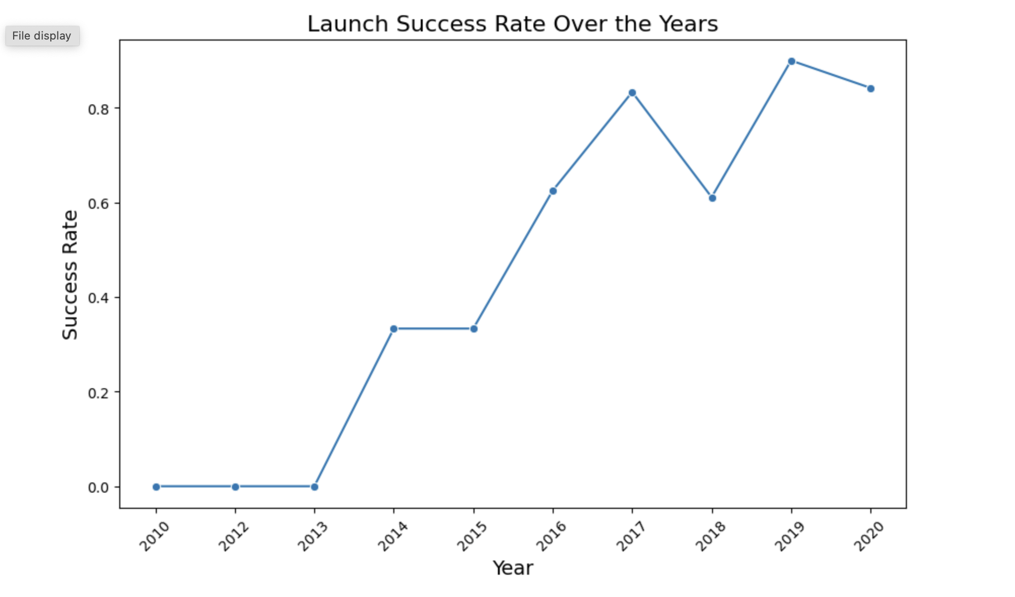
Launch Success Yearly Trend
Show a line chart of yearly average success rate
Explanations:
The success rate is increasing over the years.

Slide 25
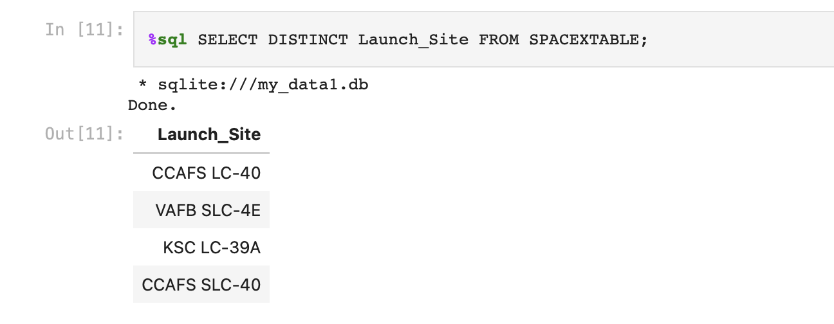
All Launch Site Names
Find the names of the unique launch sites
Explanation: 5 sites are found

Slide 26
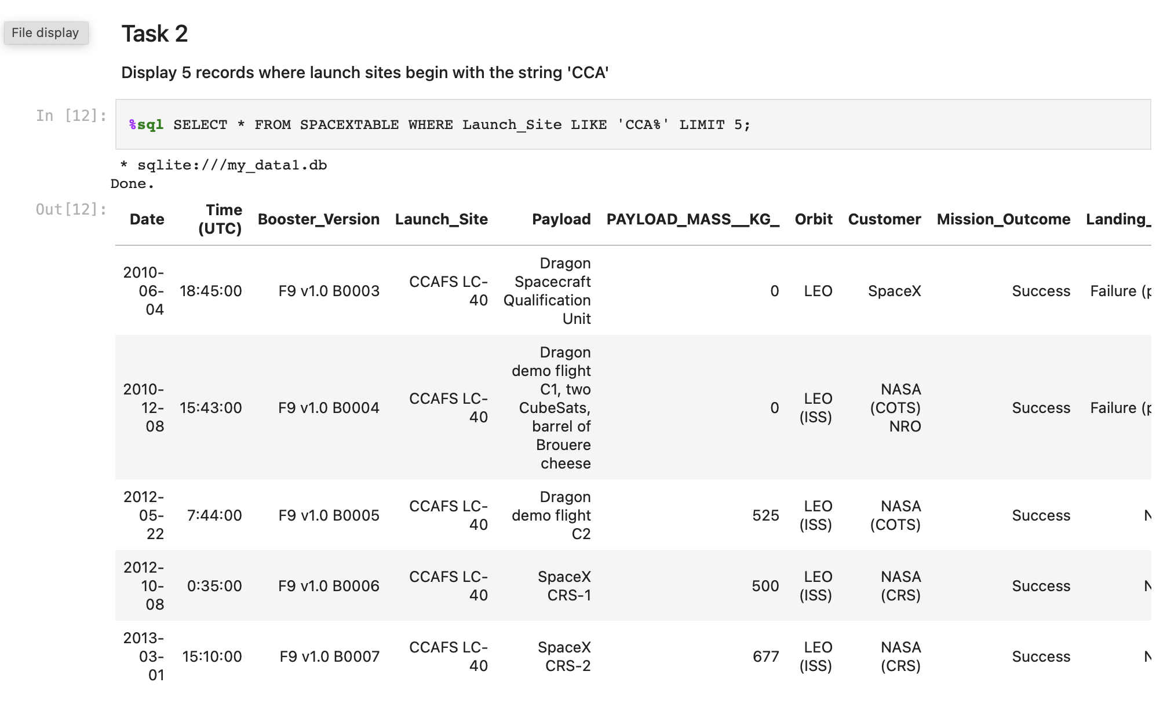
Launch Site Names Begin with 'CCA'
Find 5 records where launch sites begin with `CCA`

Slide 27
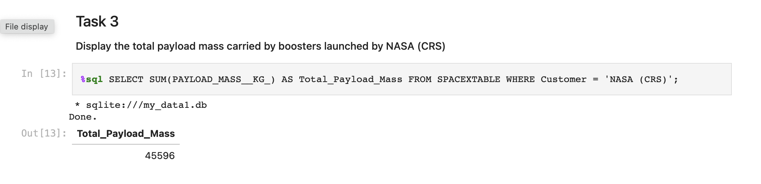
Total Payload Mass
Calculate the total payload carried by boosters from NASA

Slide 28
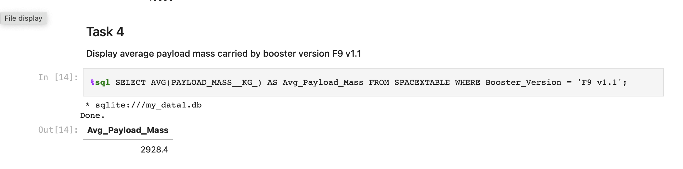
Average Payload Mass by F9 v1.1
Calculate the average payload mass carried by booster version F9 v1.1
Present your query result with a short explanation here

Slide 29
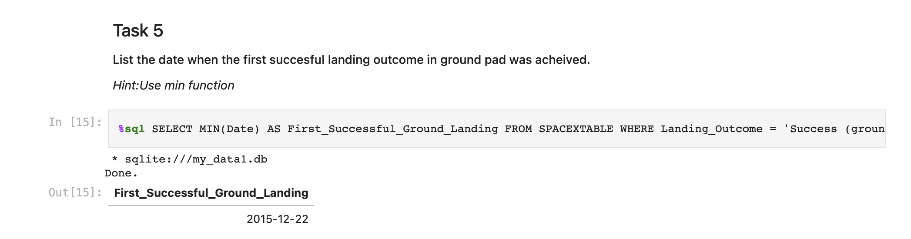
First Successful Ground Landing Date
Find the dates of the first successful landing outcome on ground pad
Present your query result with a short explanation here

Slide 30
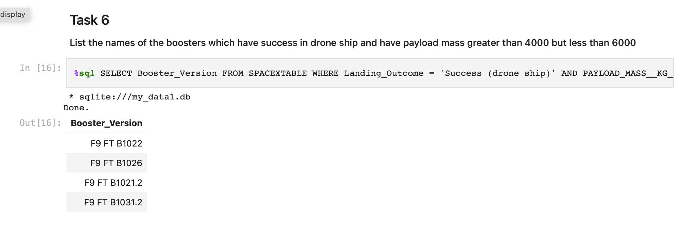
Successful Drone Ship Landing with Payload between 4000 and 6000
List the names of boosters which have successfully landed on drone ship and had payload mass greater than 4000 but less than 6000

Slide 31
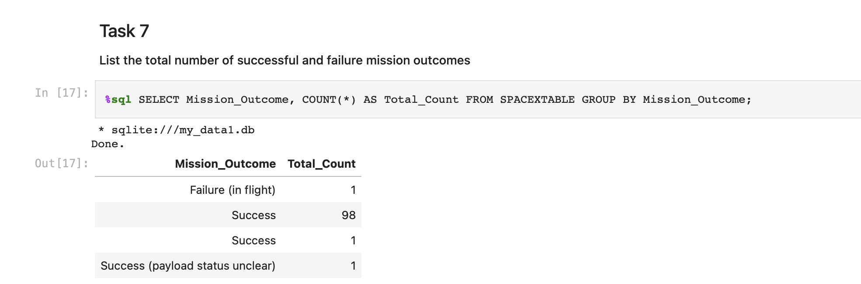
Total Number of Successful and Failure Mission Outcomes
Calculate the total number of successful and failure mission outcomes
Present your query result with a short explanation here

Slide 32
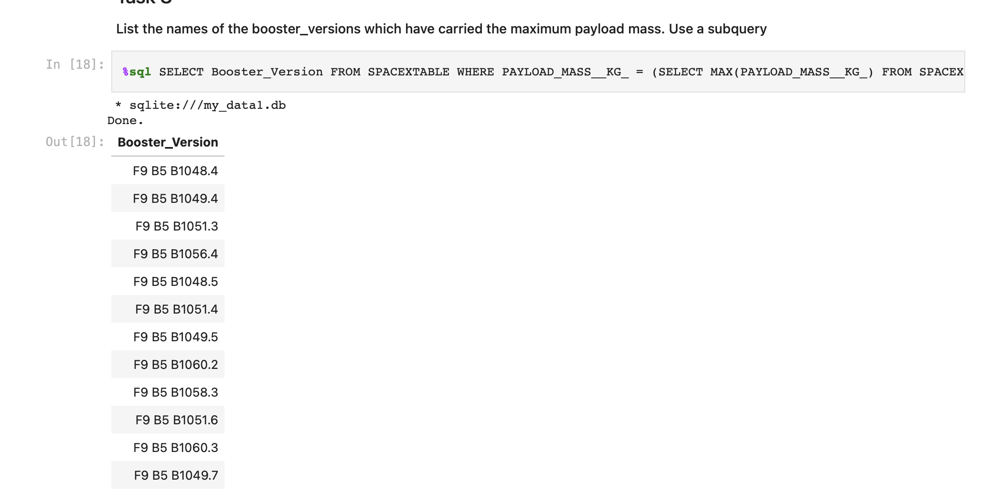
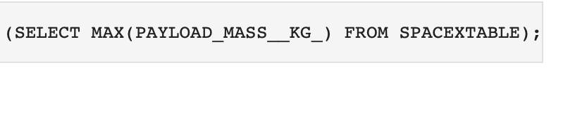
Boosters Carried Maximum Payload
List the names of the booster which have carried the maximum payload mass
Present your query result with a short explanation here

Slide 33
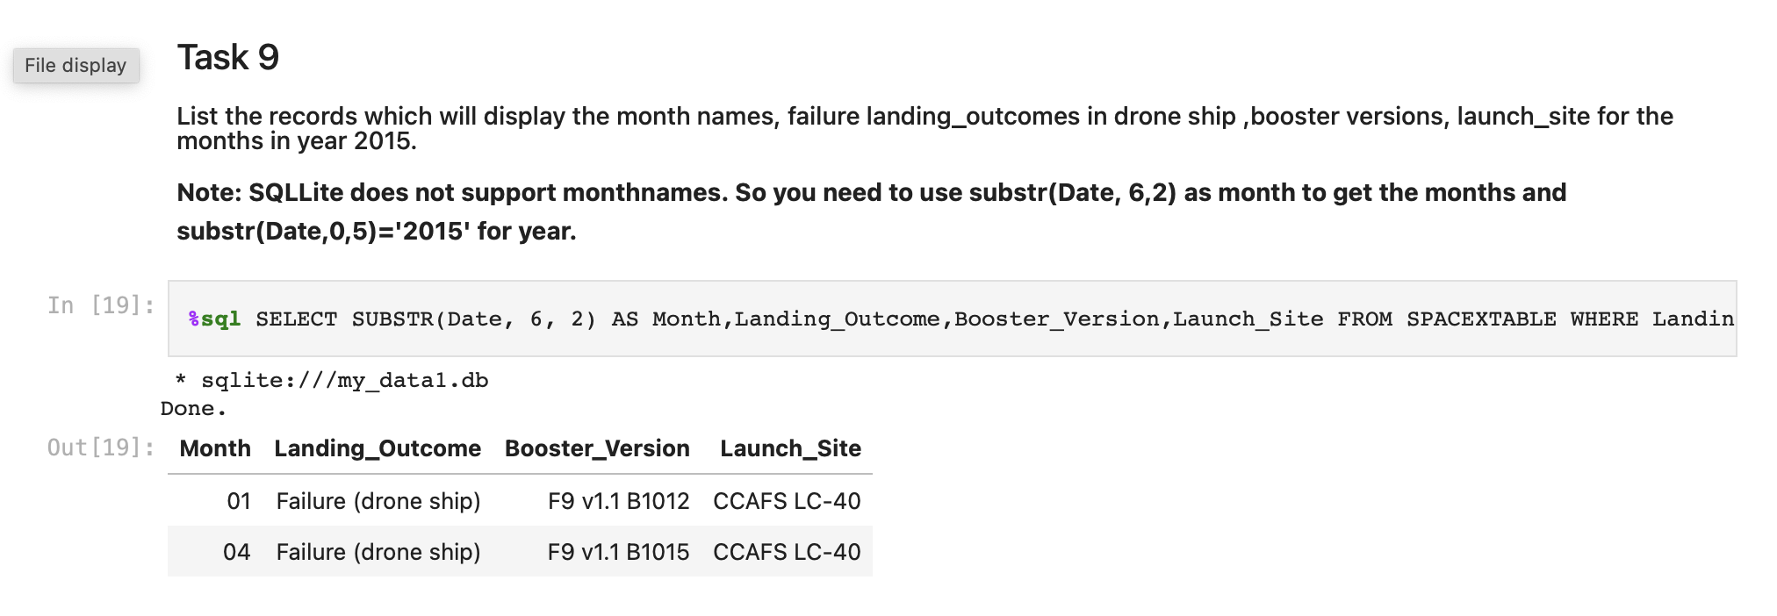
2015 Launch Records
List the failed landing_outcomes in drone ship, their booster versions, and launch site names for in year 2015
Present your query result with a short explanation here

Slide 34
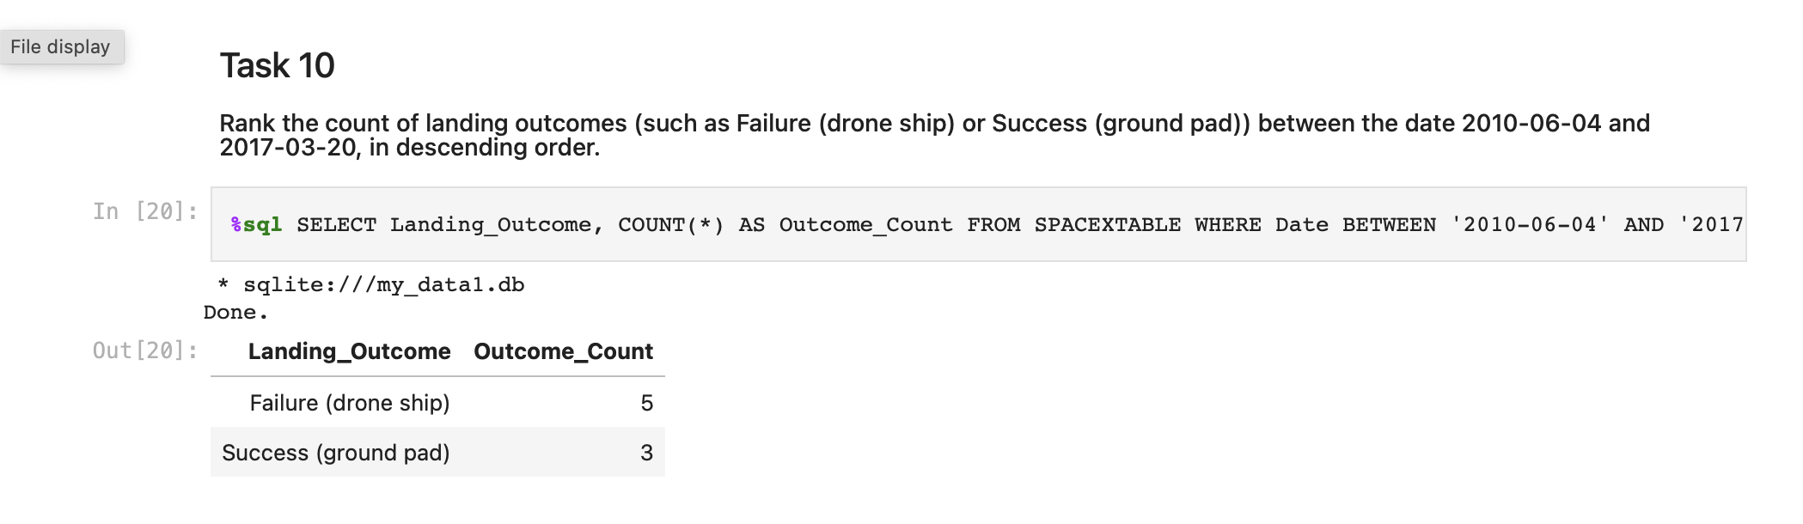
Rank Landing Outcomes Between 2010-06-04 and 2017-03-20
Rank the count of landing outcomes (such as Failure (drone ship) or Success (ground pad)) between the date 2010-06-04 and 2017-03-20, in descending order
%sql SELECT LANDING_OUTCOME, COUNT(*) AS OUTCOME_COUNT FROM SPACEXTABLE WHERE DATE BETWEEN '2010-06-04' AND '2017-03-20' AND LANDING_OUTCOME IN ('FAILURE (DRONE SHIP)', 'SUCCESS (GROUND PAD)') GROUP BY LANDING_OUTCOME ORDER BY OUTCOME_COUNT DESC;

Slide 35

Section 3

Slide 36
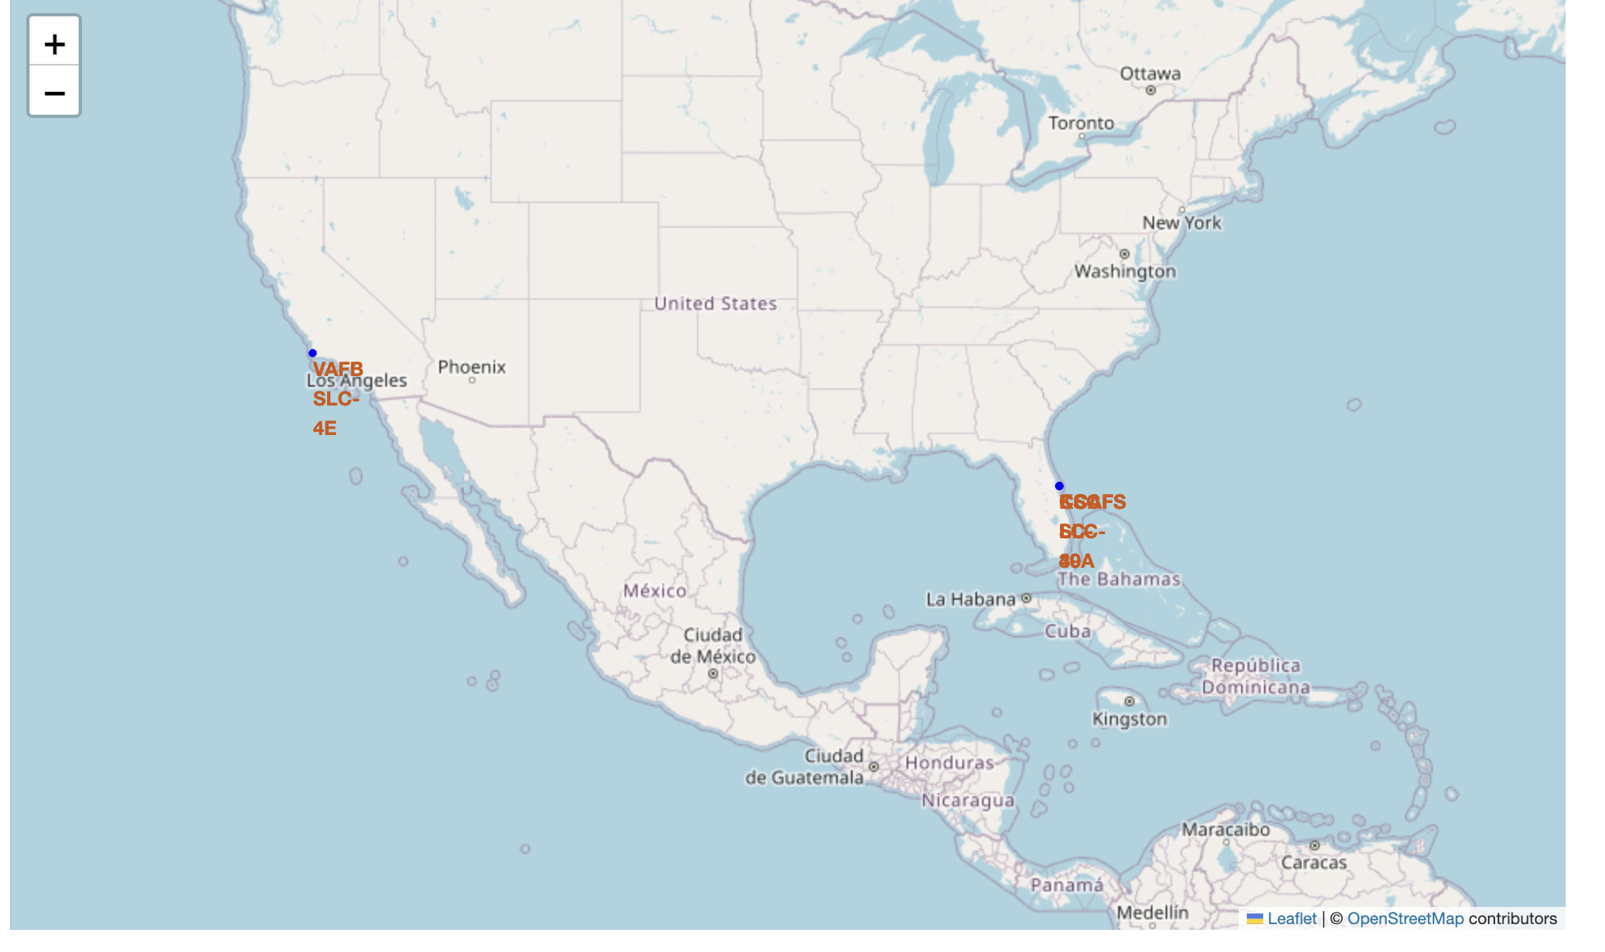
All launch sites in US
Replace <Folium map screenshot 1> title with an appropriate title
Explore the generated folium map and make a proper screenshot to include all launch sites’ location markers on a global map
Explain the important elements and findings on the screenshot

Slide 37
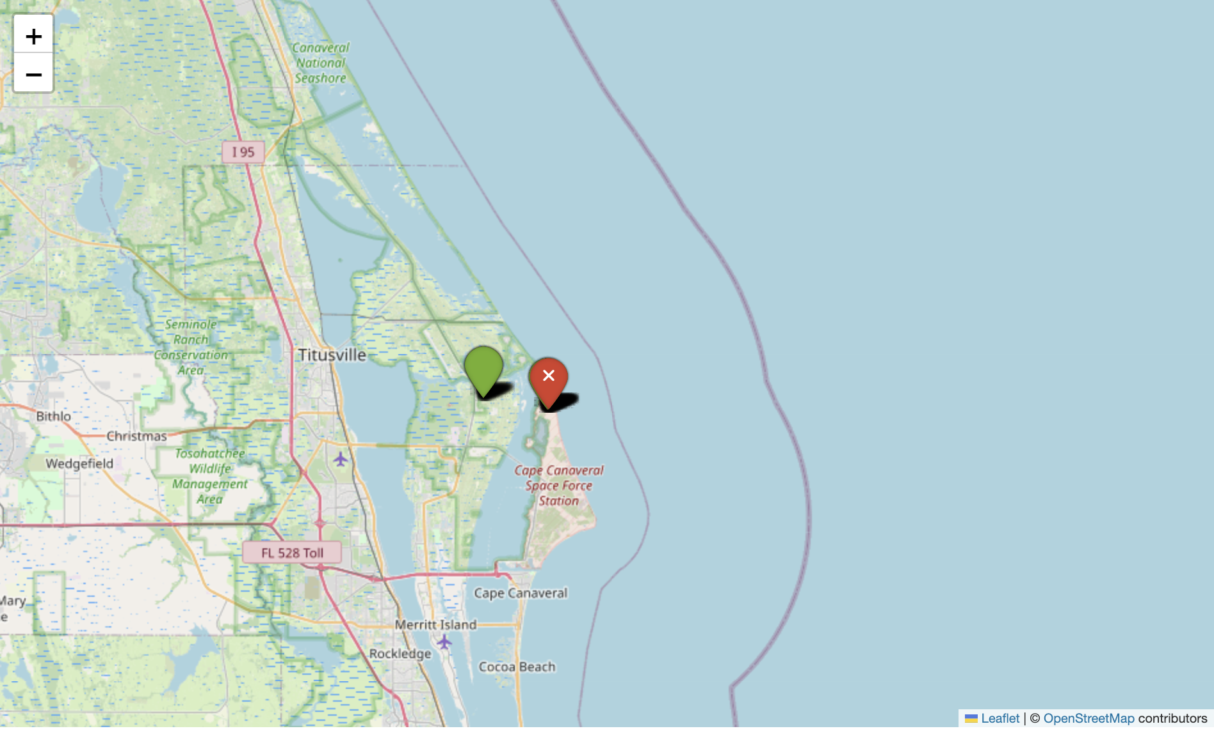
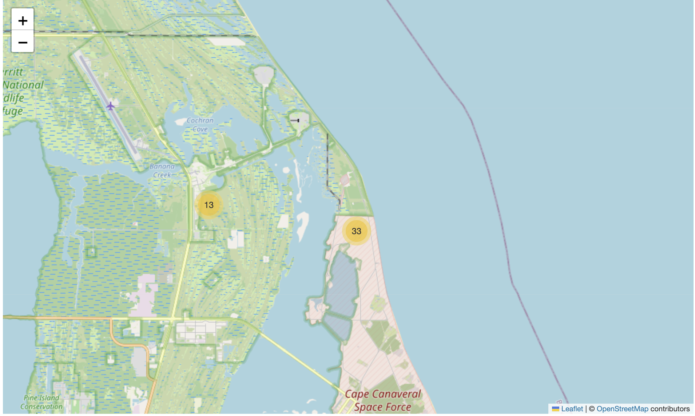
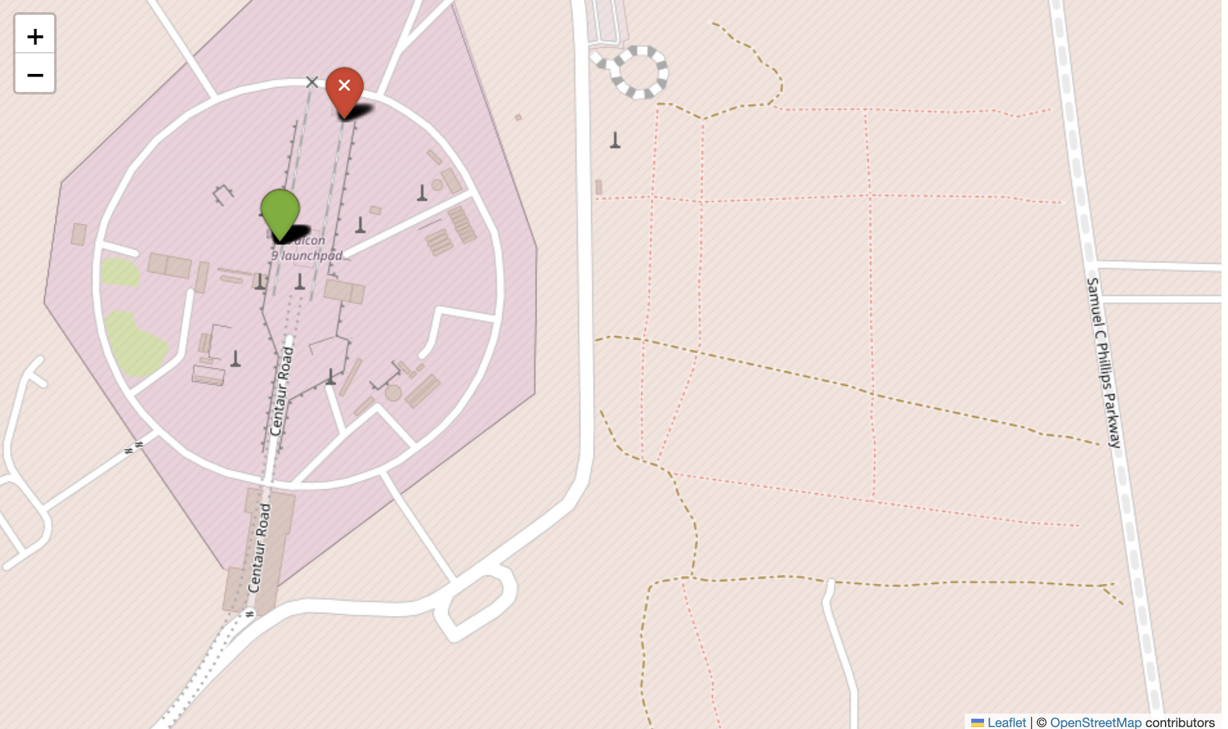
Launch sites with circles and labels

Slide 38
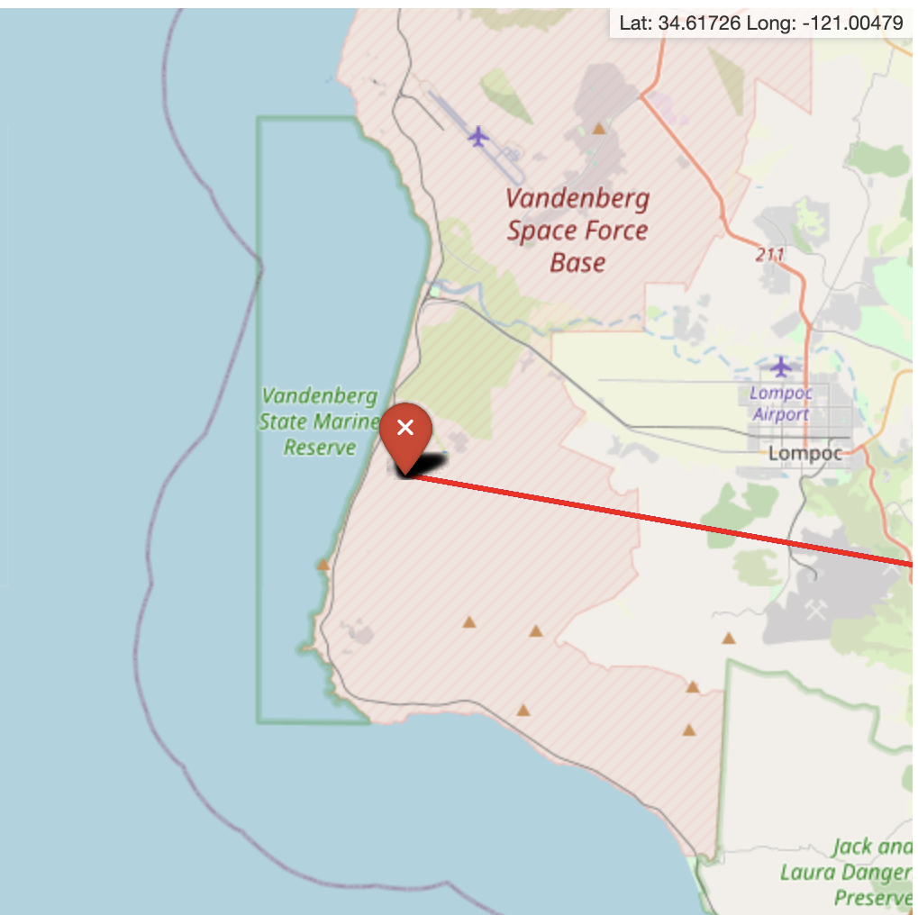
Distance to the highway

Slide 39

Section 4

Slide 40
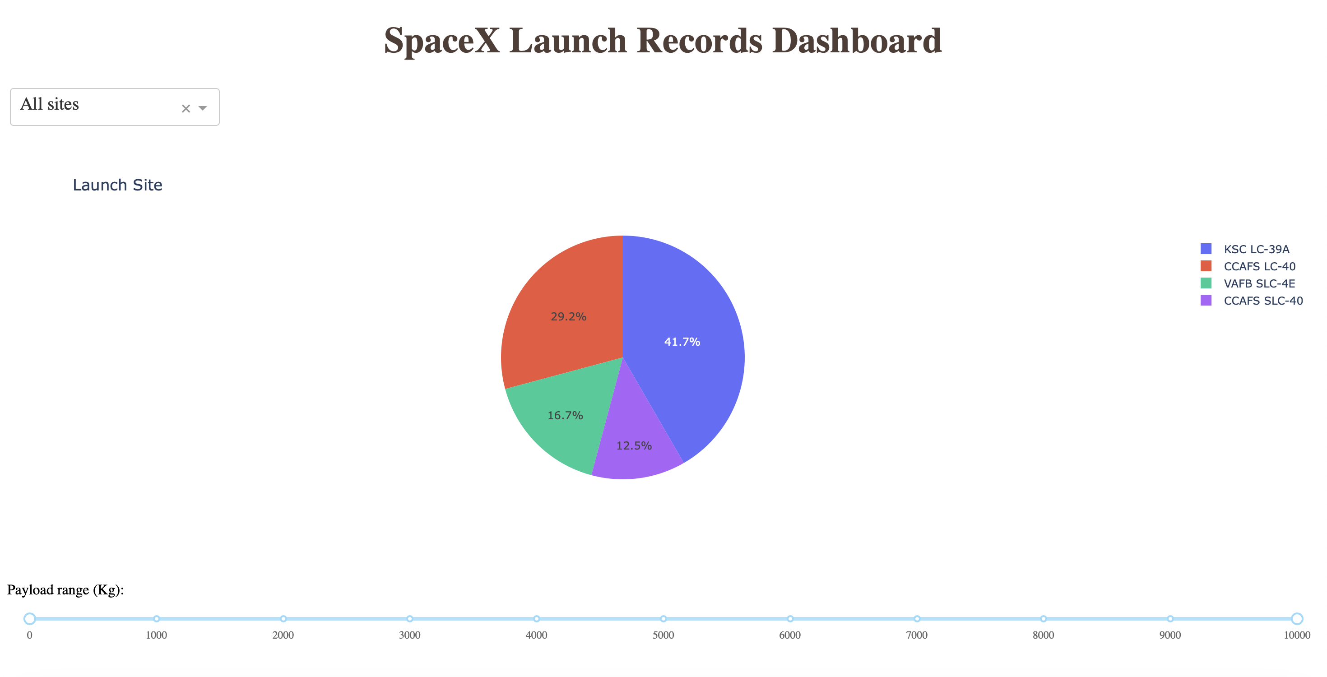
Dashboard pie chart
Replace <Dashboard screenshot 1> title with an appropriate title
Show the screenshot of launch success count for all sites, in a piechart
Explain the important elements and findings on the screenshot

Slide 41
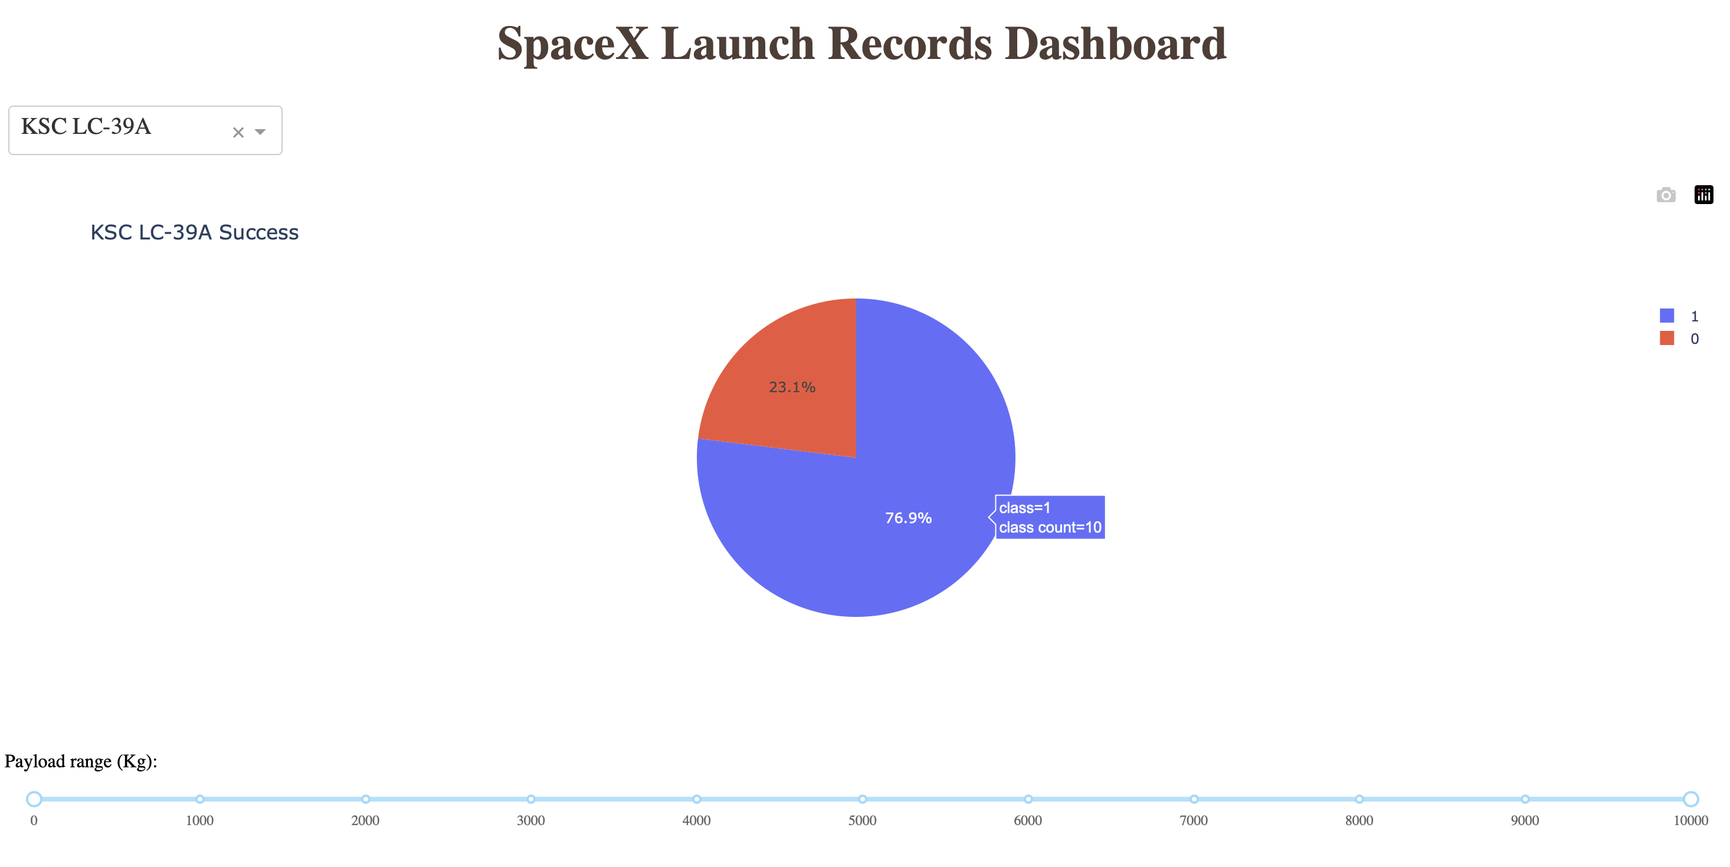
Launch site with highest launch success ratio
Replace <Dashboard screenshot 2> title with an appropriate title
Show the screenshot of the piechart for the launch site with highest launch success ratio
Explain the important elements and findings on the screenshot

Slide 42
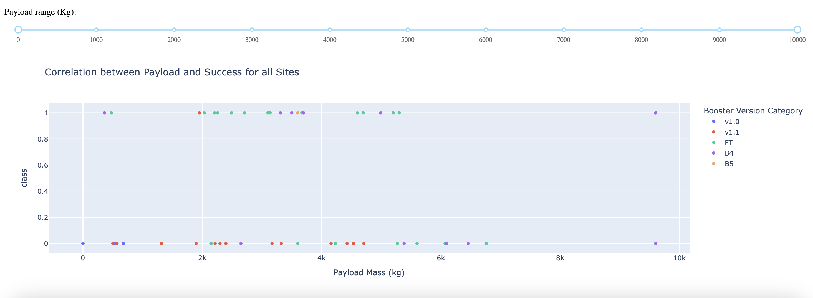
Payload vs. Launch Outcome scatter plot for all sites
0-10000
Replace <Dashboard screenshot 3> title with an appropriate title
Show screenshots of Payload vs. Launch Outcome scatter plot for all sites, with different payload selected in the range slider
Explain the important elements and findings on the screenshot, such as which payload range or booster version have the largest success rate, etc.

Slide 43
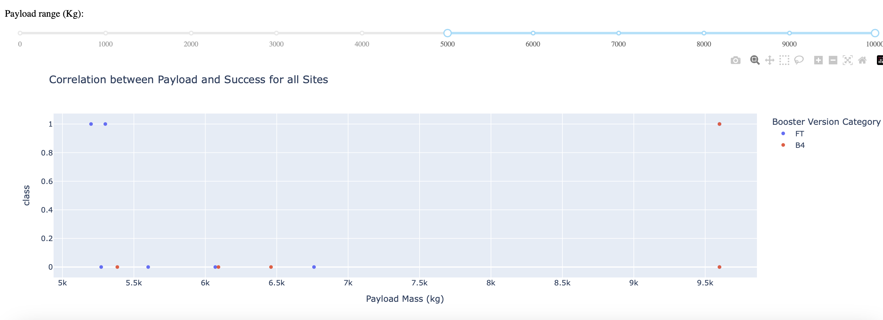
Payload vs. Launch Outcome scatter plot for all sites
5000-10000
Replace <Dashboard screenshot 3> title with an appropriate title
Show screenshots of Payload vs. Launch Outcome scatter plot for all sites, with different payload selected in the range slider
Explain the important elements and findings on the screenshot, such as which payload range or booster version have the largest success rate, etc.

Slide 44
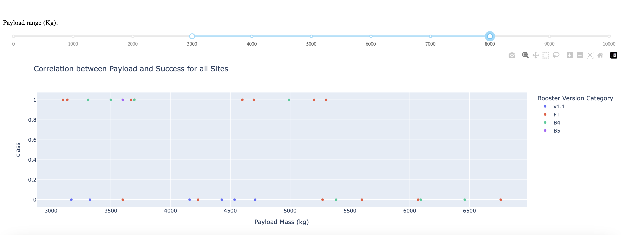
Payload vs. Launch Outcome scatter plot for all sites
3000-8000
Replace <Dashboard screenshot 3> title with an appropriate title
Show screenshots of Payload vs. Launch Outcome scatter plot for all sites, with different payload selected in the range slider
Explain the important elements and findings on the screenshot, such as which payload range or booster version have the largest success rate, etc.

Slide 45

Section 5

Slide 46
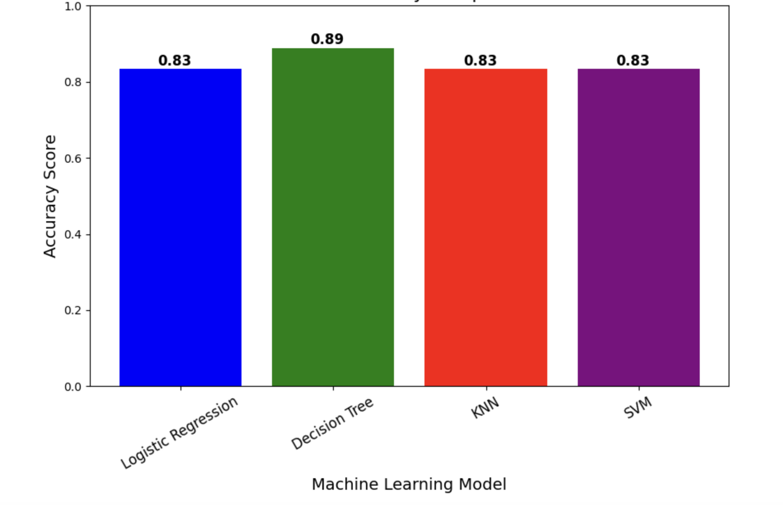
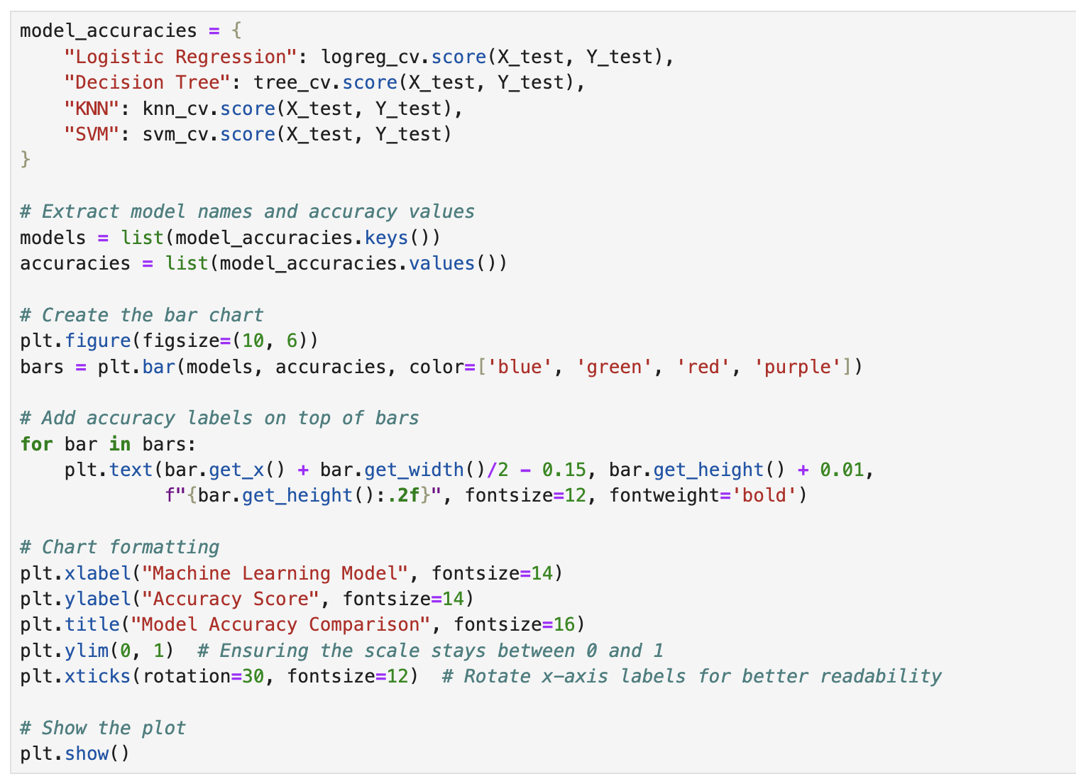
Classification Accuracy → Decision tree
Visualize the built model accuracy for all built classification models, in a bar chart
Find which model has the highest classification accuracy

Slide 47
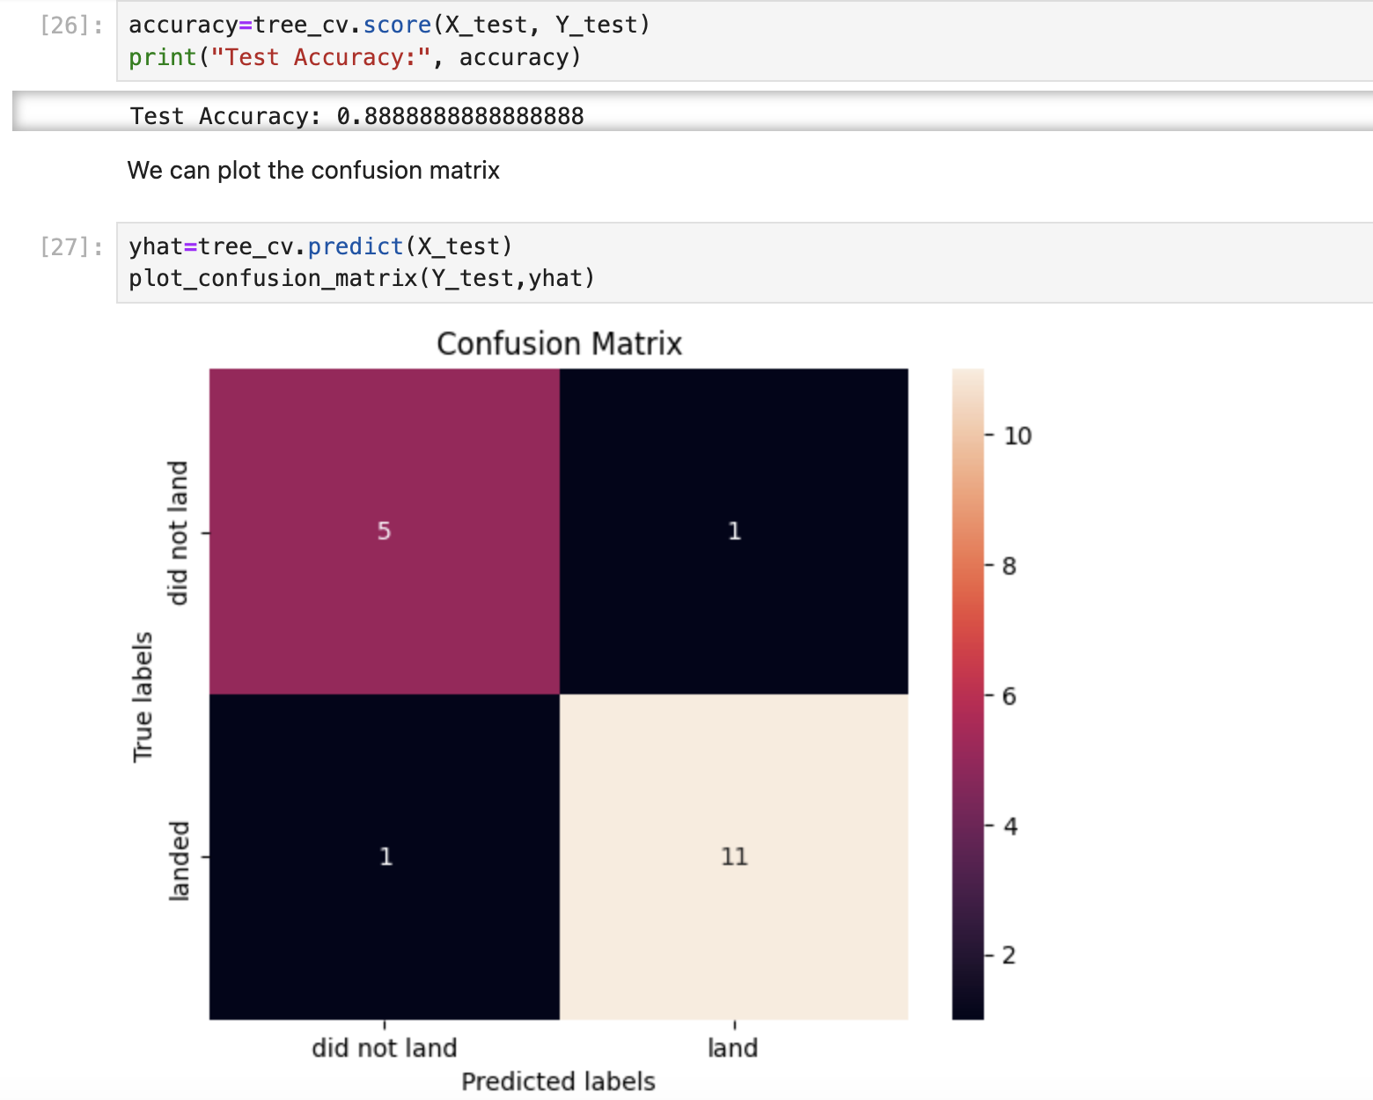
Confusion Matrix
Explanation:
Handles Categorical & Numerical Data Well:
The dataset contains categorical data (e.g., booster version category, launch site) and numerical data (e.g., payload mass). Decision Trees are good at handling both types without complex preprocessing.
Captures Non-Linear Relationships:
Unlike Logistic Regression, which assumes linear relationships, Decision Trees can model complex decision boundaries.
• Interpretable & Explainable:
Decision Trees provide a clear structure that explains why a specific prediction was made, unlike SVM or Neural Networks, which are often black-box models.

Slide 48
Conclusions
• The analysis identified several key factors that correlate with successful landings:
• Payload Mass: Higher payloads tend to have higher success rates in specific orbits (e.g., LEO, ISS, and Polar orbits).
• Launch Site: Certain launch sites exhibit higher success rates, with KSC LC 39A and CCAFS SLC 40 being the most reliable.
• Orbit Type: GTO (Geostationary Transfer Orbit) has the lowest success rate, while SSO, GEO, and ES-L1 have 100% success rates.
• The study confirms that machine learning models can predict the success of SpaceX Falcon 9 rocket landings with high accuracy.
• The Decision Tree model achieved the highest classification accuracy (89%), making it the most effective at predicting landing outcomes.

Slide 49
Appendix
Include any relevant assets like Python code snippets, SQL queries, charts, Notebook outputs, or data sets that you may have created during this project

Slide 50


